Slide 1
The Multimodal Universe Dataset
Ali Ahmed

Slide 2
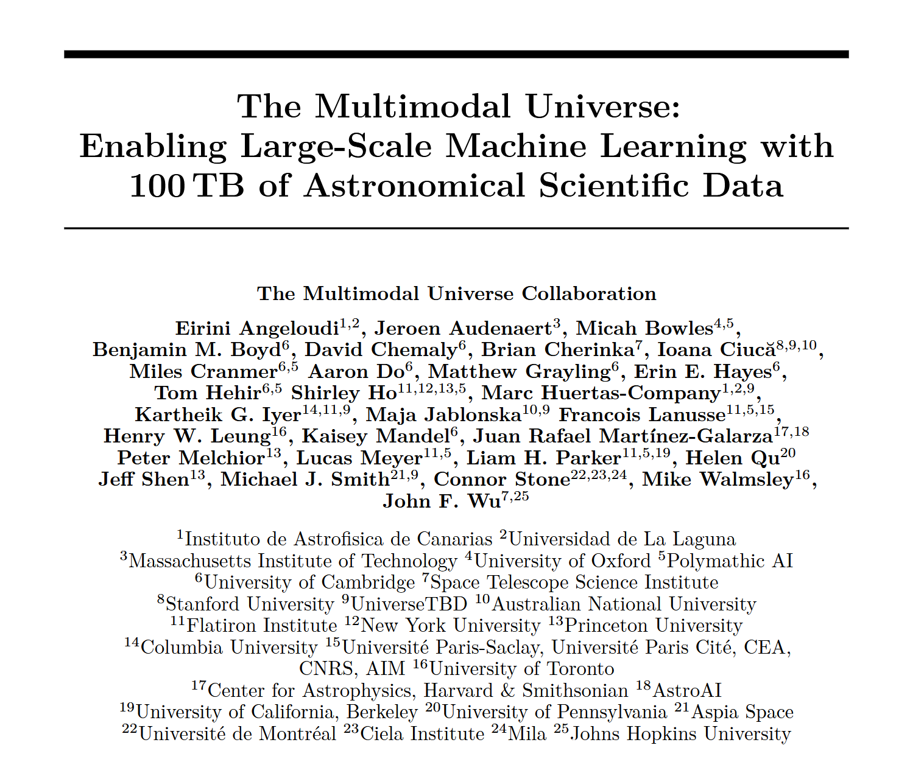

Slide 3


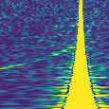
The Problem
Large astronomical datasets available
SDSS (Galaxies)
ATLAS (NEO Detection)
Not enough professional time to identify each object – Citizen scientist projects?
Galaxy ZOO Project → Classification of galaxies
Gravity Spy → LIGO/Virgo Data

Slide 4
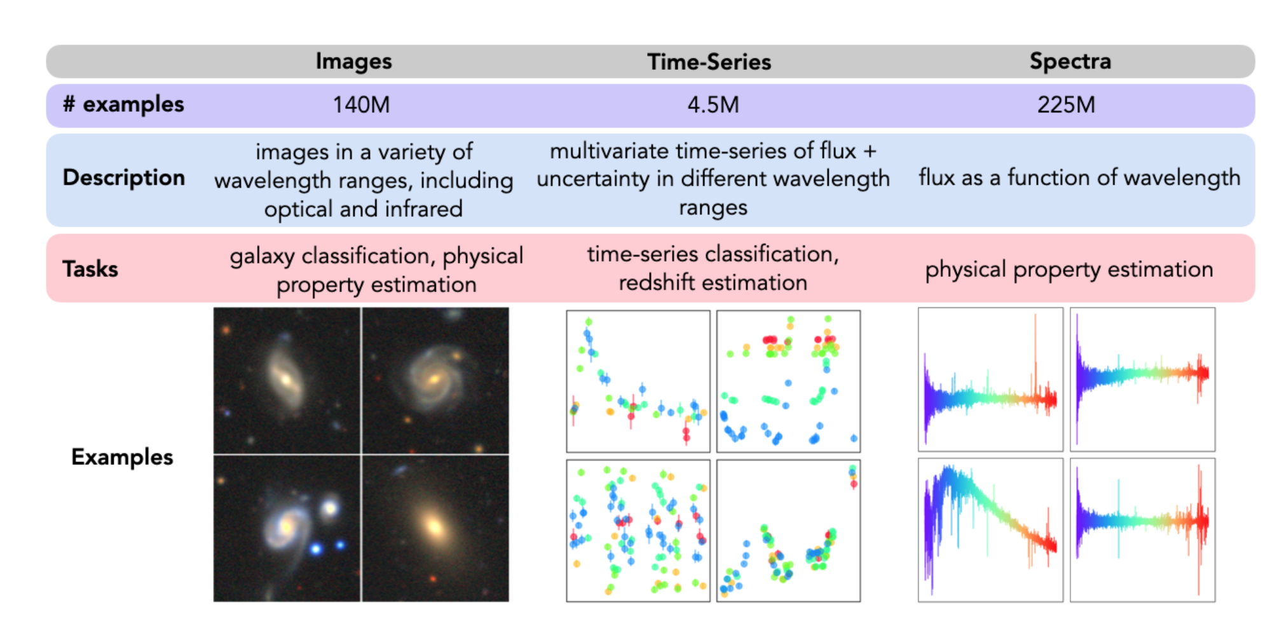

Slide 5
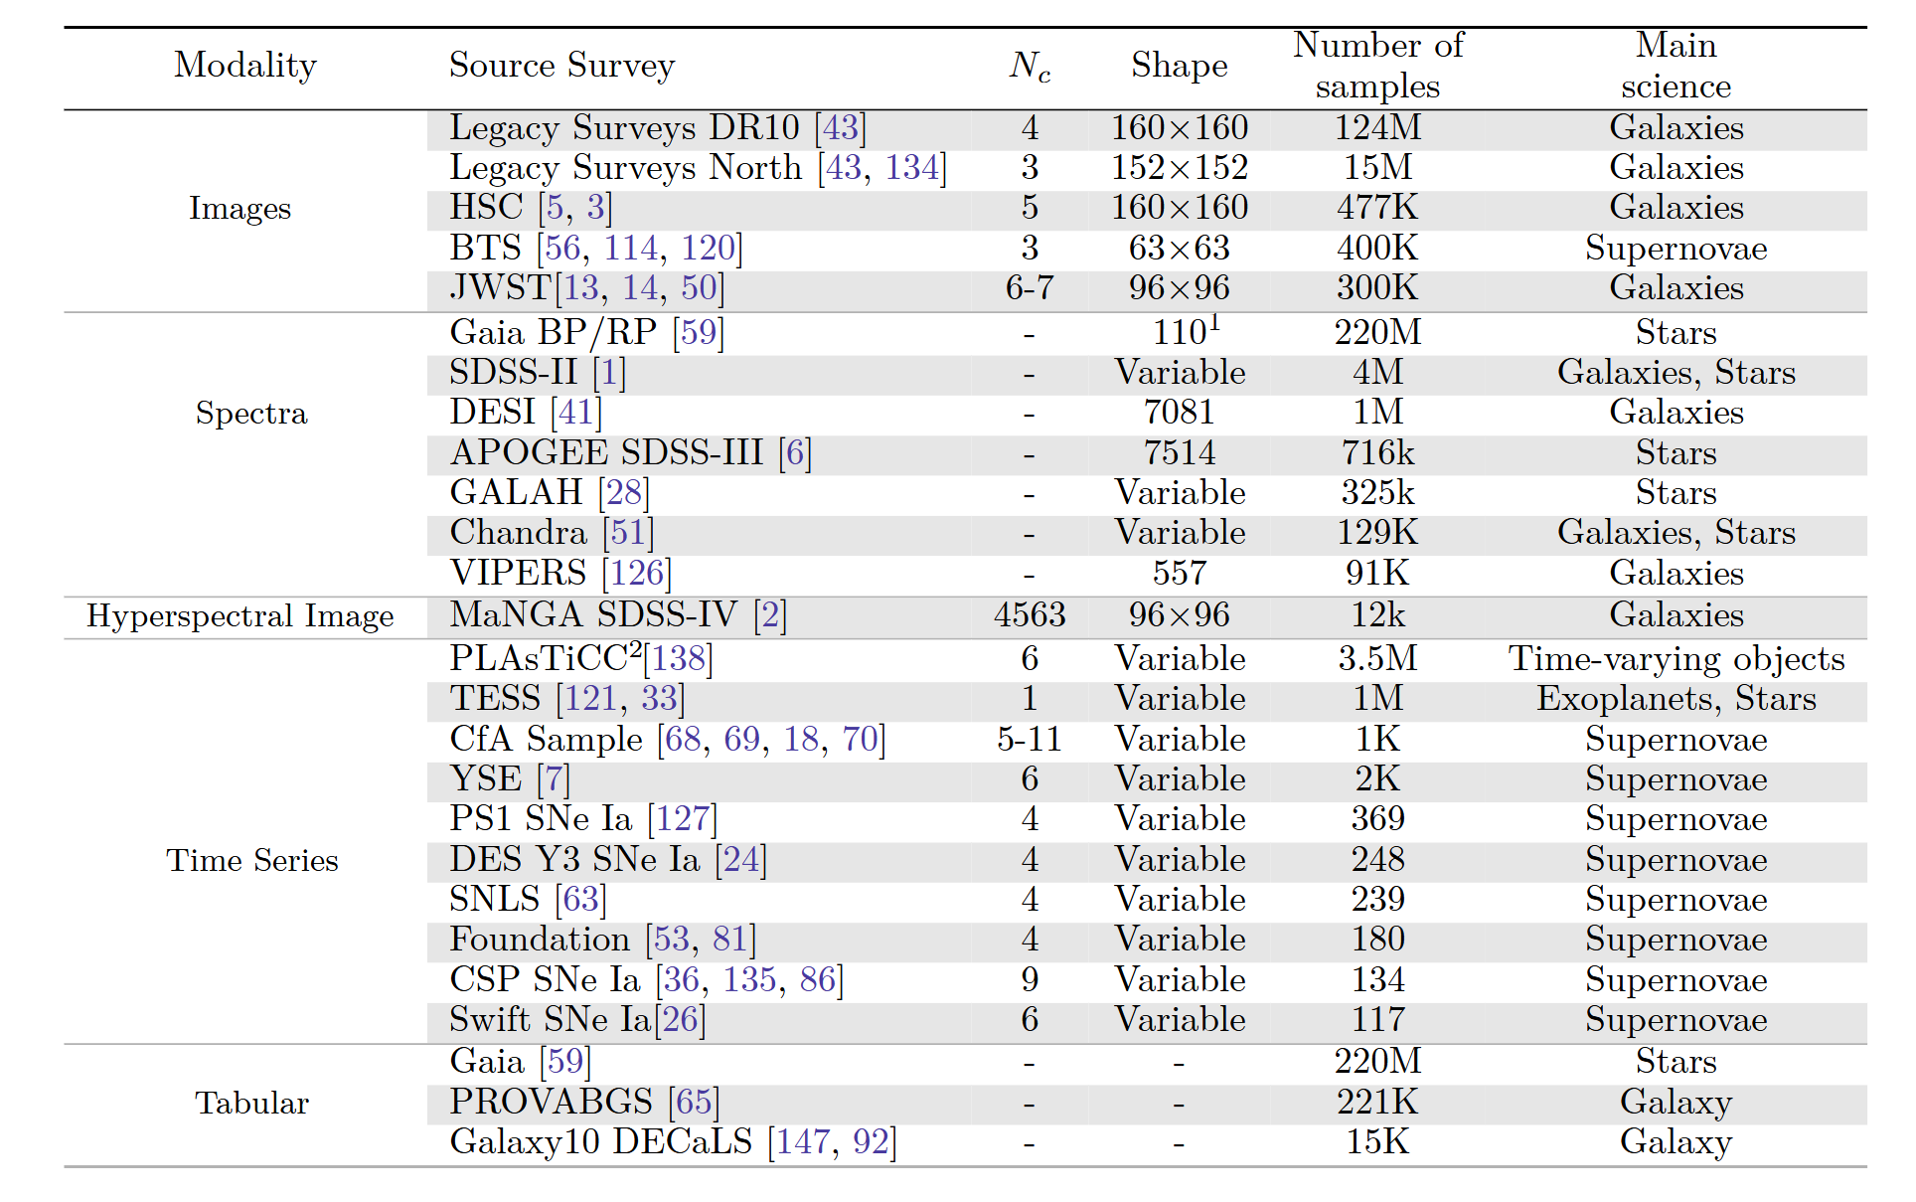

Slide 6
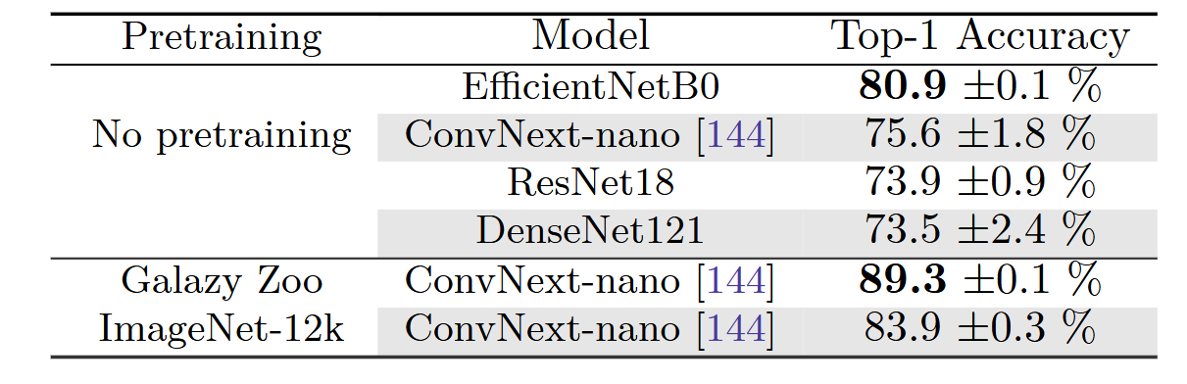
Galaxy Morphology Classification

Slide 7
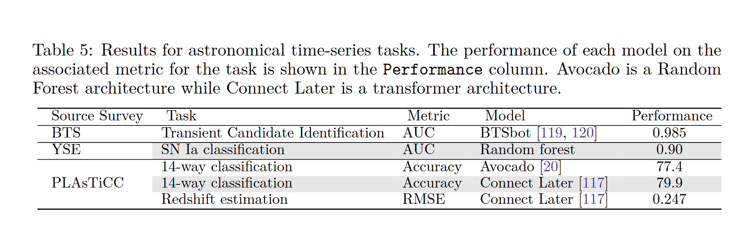
Astronomical Time Series Classification

Slide 8
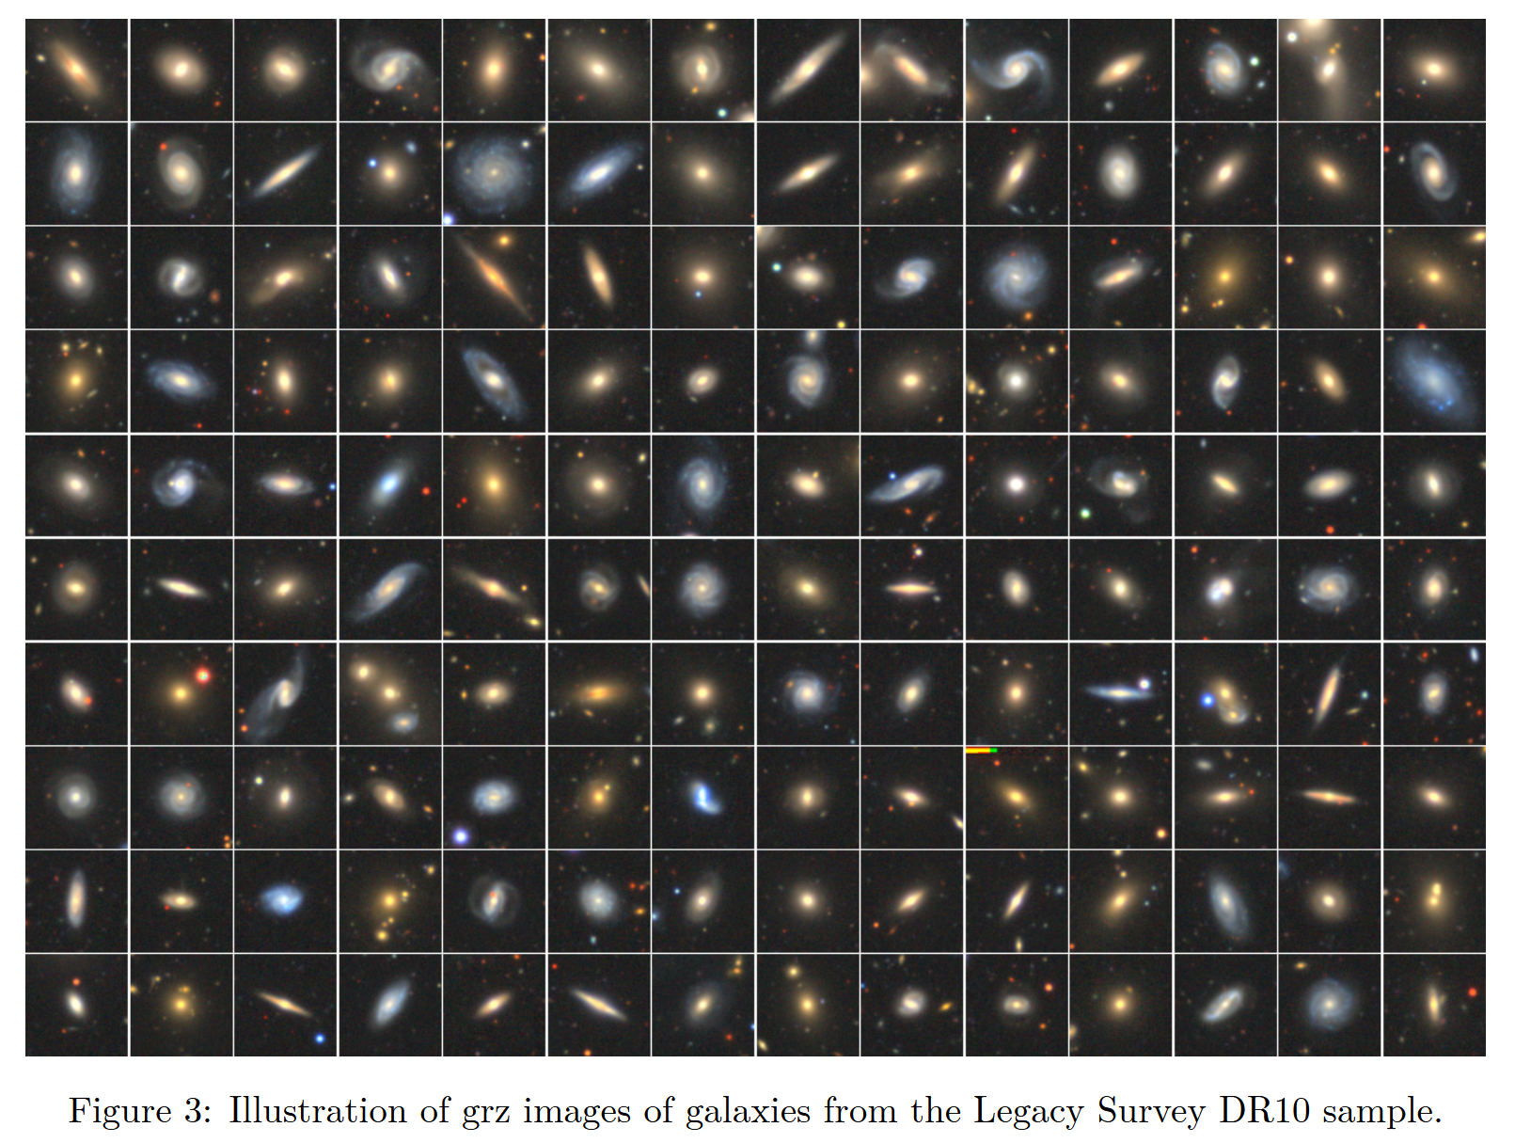

Slide 9
Further Steps and Future
Provides standardized dataset - preexisting datasets too specialized
Types of data too specialized for outsiders to understand
Metadata not included
Researcher preferences
Error bars???
Brand new dataset aggregation—no existing models trained off of it (yet)
Multimodal nature provides avenues to train large transformers to rapidly scan/classify/generate data

